Slide 1
Integrated School Governance
Building a Solid System for Your School’s Commitment to
Family Engagement
Notes:
Welcome and introductions

Slide 2
Outcomes:
School Leaders will gain a deeper understanding of:
Comprehensive school governance requirements as set by Federal, State and DPS Board policies
Integrating ELA-PACS, Title 1 Requirements and School Accountability Committees
Resources to move your school from compliance to commitment

Slide 3
Why Integrated School Governance?
We used to…
Operate independently to provide information, supports and resources
This created messaging that occurred on different timelines or channels, confused school leaders and internal departments.
Therefore, we came together in order to help school leaders navigate school governance compliance and commitment.
Now we…
Coordinate together to ensure consistent framing of expectations, messaging and supports
Align on timelines and next steps collectively
Notes:
This training is mainly and overview to clarify what are the minimum requirements for compliance and to try to align all to showcase how all the governance structure could be aligned. There are individual and in depth presentations for each one of the sections so please reach out to the experts for more information on those sections.

Slide 4
Theory of Action
If we align a school governance compliance structure to be concise, clear, and easy for schools to implement and provide clarity to each stakeholder’s role and overall function as a group
then schools will be able to effectively meet state, district and consent decree requirements in order to have a strong platform to collaboratively engage families, staff and community members in building strong unified partnerships which drive student achievement.

Slide 5
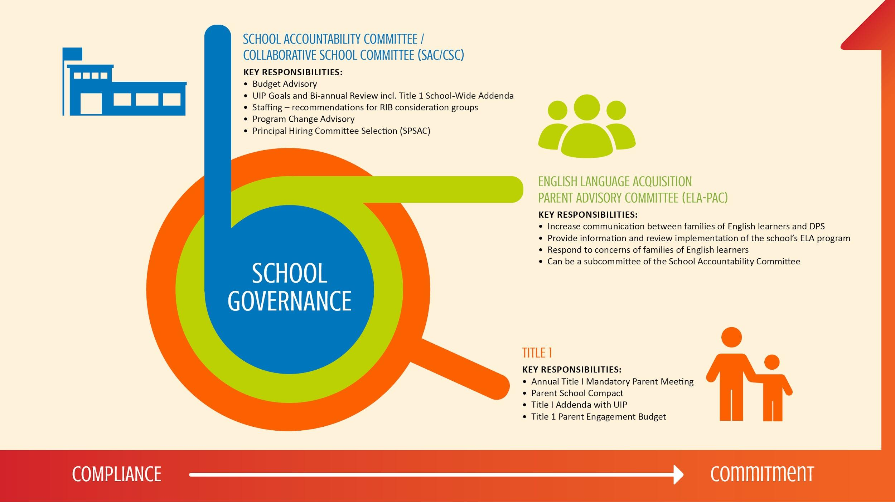
Parent Engagement Policy
Incorporate TI School-wide in UIP

Slide 6
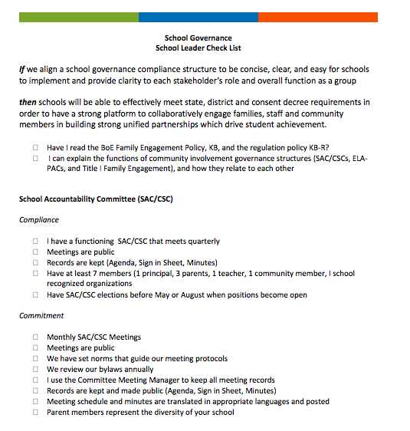
Integrated Checklist
The checklist has been designed to help school leaders and other staff consider the integration of essential SG items.
As you work through the session today, mark off items and begin your plan.

Slide 7
Compliance to Commitment | SAC/CSC
The School Accountability Committee /Collaborative School Committee brings together families, staff and community members to create and implement a plan to promote high achievement within a school.
We recommend that the SAC/CSC serves as the primary family involvement structure for schools, and that the other structures (such as Title I Family Engagement and ELA Parent Advisory Committees) function as subcommittees.
Colorado law requires all schools to have a SAC to increase the amount of accountability and family involvement in our schools.
Notes:
The concept of integrating all governance structures is not a official requirement, but a suggested best practice. Also some committees might have different name at a school but they still should serve the same function.

Slide 8
Compliance to Commitment | SAC/CSC
KEY RESPONSIBILITIES:
Budget Advisory
UIP Goals and Bi-annual Review incl. Title 1 School-Wide Addenda
Staffing –planning based on budget changes
Program Change Advisory
Principal Hiring Committee Selection (SPSAC)
Notes:
In reference to the STAFFING responsibility make sure it is clear that in In accordance with the DCTA Agreement, the CSC will Charge the Personnel Committee with the task of conducting a Reduction in Building Staff upon receipt of information that reduced the number of teaching assignments at a school, or when the CSC decides fewer teaching assignments are needed in a department, grade level, or ELA/specialty area.

Slide 9
Compliance to Commitment | SAC/CSC
The SAC does NOT:
Participate in the day-to-day operations of the school
Involve itself in issues relating to individuals (staff, students, or parents) within the school
Involve itself in personnel issues (the School Personnel Committee will stand alone according to the current DPS/DCTA contract)
Advocate for their own perspective, rather than for the greater good of the school

Slide 10
Compliance to Commitment | SAC/CSC
COMPLIANCE
COMMITMENT
SAC meets quarterly
Meetings are public
Records are kept and made public (Agenda, Sign in Sheet, Minutes)
Have at least 7 members (1 principal, 3 parents, 1 teacher, 1 community member, I member of a school recognized organization
Have SAC elections before May or August for open positions
SAC meets monthly
Meetings and minutes are posted
Minutes are translated in common languages
Has increased membership to ensure representation of all stakeholders

Slide 11
Research | Participation in SAC/CSC
Participation in School Governance Structures shows significant growth in parents/guardians self perceived level of engagement and academic partnership.
Parents who are members of the SAC/CSC or other school governance programs report deeper levels of academic partnership.
Notes:
The survey of Academic Partnership is a Survey given to DPS families to measure their feelings of empowerment and involvement. The survey score is based on a score of 1 - 4

Slide 12
Compliance to Commitment | ELA
The Legal Responsibilities of an ELA PAC according to the Consent Decree are:
Provide families information about ELA programming
Increase communication between families and schools
Review the implementation of ELA programming
Listen and respond to family concerns
Notes:
These are the legal requirements listed in the Consent Decree. Information and communication needs to be in families’ native languages and feedback needs to be collected and responded to.

Slide 13
Compliance to Commitment | ELA
English Language Acquisition District Advisory Committees (ELA DAC)
District-level committee for parents of English learners that meets monthly. The purpose of the ELA DAC is to support ELA PACs, increase communication between parents of English learners and DPS, and build parent leadership. ELA DACs are combined with Superintendent Parent Forums (SPFs), Family Leadership Institutes (FLIs) and School Governance Meetings.
Notes:
These are the legal requirements for DACs. Schools need to share information about these opportunities with parents and help support at least one parent to attend each month.

Slide 14
Compliance to Commitment | ELA
COMPLIANCE
COMMITMENT
ELA PAC Meetings twice a year that are open to all families of students receiving ELA services
At least 1 ELA PAC member or a staff member attends ELA DAC meetings
Agendas, minutes and sign-in sheets are on file for ELA PAC meetings
All publicly posted minutes and agendas are translated into most common languages
Monthly ELA PAC meetings
ELA PAC meeting information/ feedback is included in CSC meetings
Multiple ELA PAC members attend ELA DACs
The content of some of the ELA PAC meetings is determined by families
Notes:
Compliance is the legally mandated minimum for all ELA Program schools

Slide 15
Compliance to Commitment | ELA
Getting your ELA PAC started:
Identify a DPS employee to be your PAC contact
Parent outreach
Lead meetings (preferably in cooperation with parent leaders)
Record meetings and save sign-in sheets
Plan meeting agendas based on parent needs and requests
Must meet at least twice per year
Must discuss ELA Program at your school and respond to parent concerns
Use translation and interpretation resources
Notes:
There are additional resources to support you, including templates and sample presentations, available in the ELA PAC Schoology group (more information later in resources)

Slide 16
Compliance to Commitment | ELA
Ensuring your ELA PAC participates in the ELA DAC:
Identify parent representatives for SPF/ELA DAC meetings
Elect ELA Board Representatives along with CSC reps (can overlap!)
Regular attendance is important but meetings are still open to any/all ELA families
Ensure ELA DAC information is shared with PAC members
Notes:
Depending on your school’s needs, DAC reps don’t HAVE to be elected or the same person every time. Meetings are open to any and all ELA families.

Slide 17
Compliance to Commitment | ELA
ELA PAC Resources:
PAC Toolkit
ELA Website
Commons: School Committees
Language Services
Family and Community Engagement
Resources to support immigrant and refugee families
Schoology
http://www.colorincolorado.org/
Hope Flores, new ELA PAC coordinator , x32204

Slide 18
Compliance to Commitment | Title I
History
Written into Law in 1965, Title I is a federal formula grant which supports our high need student populations. It is based on poverty data for the district and allocated to schools according to Free & Reduced Lunch (FRL) populations.
Formula grants, unlike competitive grants, are guaranteed funding streams from federal agencies for supporting populations who otherwise may not have the opportunity to receive fiscal and programmatic supports.

Slide 19
Compliance to Commitment | Title I
How Does Title I Support Student Achievement?
All federal funds are supplemental to support the whole child; including academic and social emotional learning.
The Unified Improvement Plan (UIP) & Title I School-Wide Program: By Completing a High Quality UIP you will meet the TI School-Wide Program.
Why? They are integrative programs working together to raise Student Achievement
Parent Engagement: 1% of the district’s Title I budget will be distributed to schools to support parent engagement.

Slide 20
Compliance to Commitment | UIP
How do schools address Title I in their UIP?
Note: These are requirements for all schools, regardless of Title I identification. These requirements all align to some of the components of ESSA.
UIP Component | Title I Requirement
Brief Description | School’s recent parent, family and community engagement plan. UIP Development process includes parents and community members; UIP is publicly available.
Current Performance | Disaggregated data analysis to review the performance of all student groups.
Root Cause Analysis | A school-level needs assessment.
Major Improvement Strategies | Description of how the school plans on upgrading the entire educational program to improve achievement of the lowest-achieving students.
Planning Form (Action Steps and Benchmarks) | Identification of how the plan will be operationalized and progress monitored. Steps to include parents, family and the community in the improvement efforts.

Slide 21
Compliance to Commitment | Title I
COMPLIANCE
COMMITMENT
Have a Parent Engagement Policy (Title I and Board Policy requirement)
Have a Parent School Compact and share it with all parents
Hold a TI Mandatory Parent Meeting in the 1st trimester; submit agenda and sign-in sheet by the 2nd week of November
School-wide program in UIP
Work with parents to determine how to spend Title I Parent Engagement (1%)
Form academic partnership with parents
Seek feedback on the Parent Engagement Policy and Parent School Compact, modify to include feedback.
Complete High Quality UIP
Integrate Title I work into CSC or ELA-PAC meetings
Notes:
Parent Engagement
· A key component to federal compliance / Title I is that the community and parents in every Title school MUST be engaged in the decision on funding, prioritization of initiatives, and in constructions of the school wide plan (UIP)
This year CDE is planning on conducting comprehensive monitoring for many of our DPS schools. In particular they will be focusing on Title I and CS/TS/A-TS schools.
Loss of funding can occur if non-compliance.

Slide 22
Compliance to Commitment | Title I
Why it’s important schools committ to fulfill Title I requirements?
Not meeting Title I requirements puts financial supports at risk (Loss of Title I funding).
The monitoring of our Title I funding and program is critical for the compliance and audit procedures occurring throughout the grant cycle.
Notes:
This year CDE is planning on conducting comprehensive monitoring for many of our DPS schools. In particular they will be focusing on Title I and CS/TS/A-TS schools.
Loss of funding can occur if non-compliance.

Slide 23
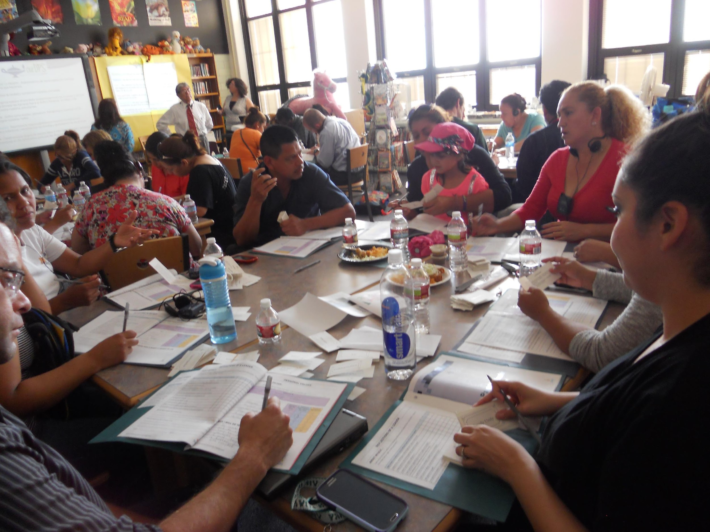
Moving to Commitment | PTLT Valverde
PTLT Compliance and Commitment
Compliance with CSC, ELA and Title I Parent Engagement
Community Voice heard
Turned the PTLT organization into umbrella organization governance
Monthly meeting
PTLT members
Principal and AP
One teacher per grade level – and they invited parents
1-2 Parents per grade level
Notes:
One innovative example of being committed to all the mentioned governance structures is Valverde’s Parent Teacher Leadership Team.
The PTLT is comprised of Teachers, parent leaders, administration and parent liaison. The purpose is to increase meaningful parent engagement and establish a culture of shared responsibility for increasing student achievement.
Understand how students are performing
Establish a sustainable PE structure
Develop PE plan aligned to academic goals on the Unified Improvement Plan
Meetings are open to all parents

Slide 24
Group Work | Case Studies
In your groups, please work through the case study at your table.
Resources to consider:
Consider the checklist you’ve been provided,
Commons Resources
http://thecommons.dpsk12.org/Page/626
Answer, consider and discuss the questions pertinent to the study.
We will share out in 10 minutes.
Notes:
Looking at the Checklist - Make sure that your bylaws are up to date- Do not assume that they are there have been changes and as a team make sure everything is current so that you are not caught of guard when you have to refer to the by laws.

Slide 25
Working Session| 6 Questions
Five questions school leaders should ask:
Can I explain the functions of community involvement governance structures (SAC/CSCs, ELA-PACs, and Title I Family Engagement), and how they relate to each other?
Does my school have a School Accountability Committee that complies with legal requirements?
Do I review the bylaws on a yearly basis?
Local 6-12 Schools
Bruce Randolph
DSST Cole
Manual Feeder
Whittier, Wyatt,
Pioneer

Slide 26
Working Session| 6 Questions
If my school is an ELA Program school, do I have a functioning ELA Parent Advisory Committee (ELA-PAC) that meets regularly?
If my school is a Title I school, am I actively engaging families to discuss Title 1 funding?
Do the involved parents at my school represent the diversity of my school's student body?
Local 6-12 Schools
Bruce Randolph
DSST Cole
Manual Feeder
Whittier, Wyatt,
Pioneer

Slide 27
Next Steps
?

Slide 28
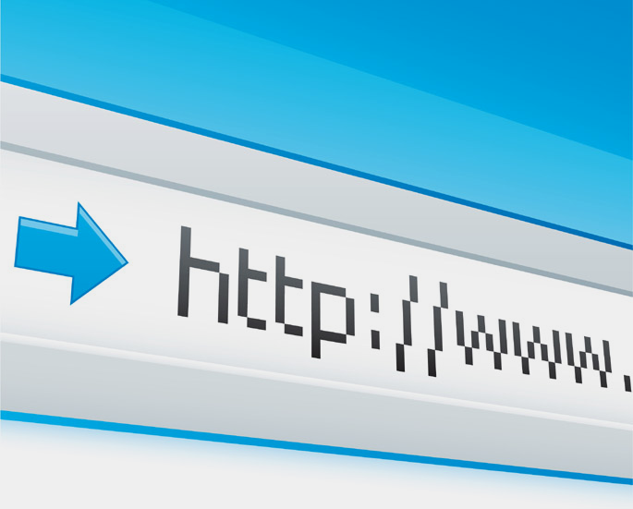
Useful Links and addresses
The Commons page and email for questions/support:
http://thecommons.dpsk12.org/Page/626
schoolgovernance@dpsk12.org
DPS Board of Education Policies:
http://www.boarddocs.com/co/dpsk12/Board.nsf/goto?open&id=AB4N685E5D86

